Slide 1
The impact of Twitter comments on the price of Bitcoin
By: Gabriel Araujo

Slide 2


BITCOIN INTRODUCTION
On 18 August 2008, the domain name bitcoin.org was registered.
Today, a single coin is worth over $50,000.00.
Bitcoin is just a fad that is highly influenced on the comments of powerful and influential people??

Slide 3




ANALYZED DATA
Bitcoin Hourly Historical Data
Scrapped Bitcoin Tweets

Slide 4
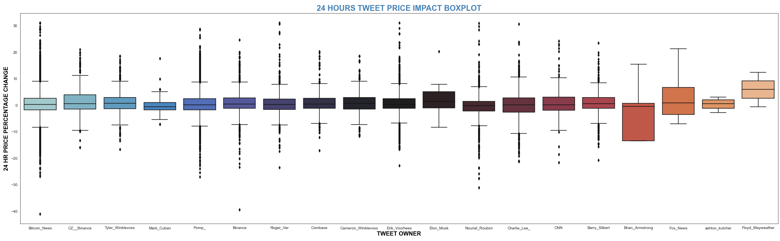
TWEET 24 HOUR IMPACT BOXPLOT

Slide 5
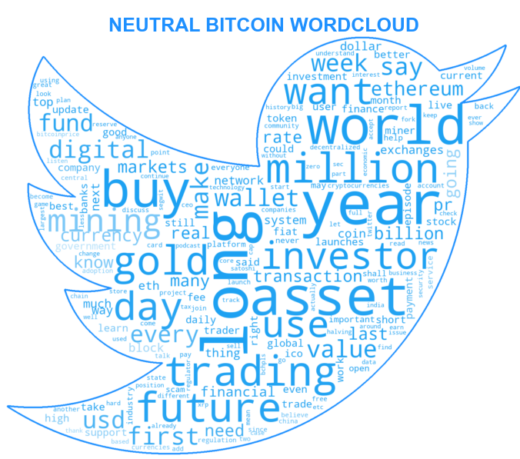

WORD CLOUDS

Slide 6
MODELS
Ensemble Method
Sentiment Analysis
Tweet Source/Owner
Tweet Features
Recurrent Neural Network
Direct Text Analysis

Slide 7


FINDINGS

Slide 8
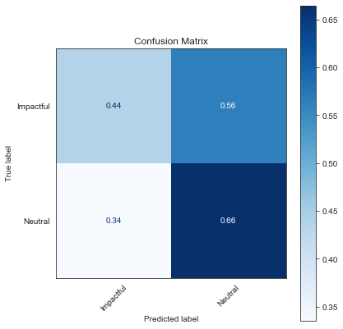
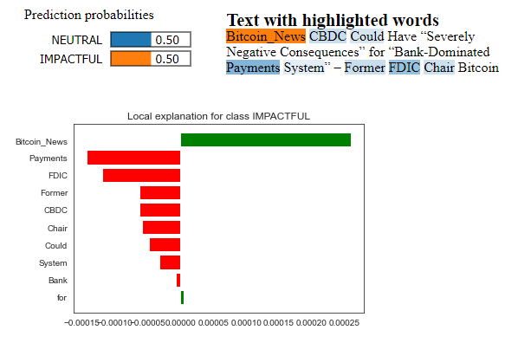
EMSEMBLE METHOD

Slide 9
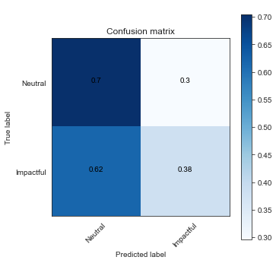
RECURRENT NEURAL NETWORK

Slide 10
CONCLUSION
After a thorough analysis of the tweets, it could not be affirmed with confidence that influential and powerful individuals have a deep influence in the price of Bitcoin.
Based on the findings, below are my recommendations:
I consider it to be very risky to invest money in Bitcoin based on comments from such people.
Tweets could not be a good source of information.
Quick trading.

Slide 11
FUTURE WORK
Collect data from more sources, such as news websites, to improve the analysis.
Tune Random Forest and Deep NLP models to increase their accuracy.
Look at incorrect predictions to see if there's a pattern.
Analyze the stock market to see if there is any correlation between the two.

Slide 12
THANK YOU FOR YOUR TIME!

Slide 13
QUESTIONS AND ANSWERS

